Slide 1


Slide 2


February Prayer Service
Cultivating Relationships

Slide 3
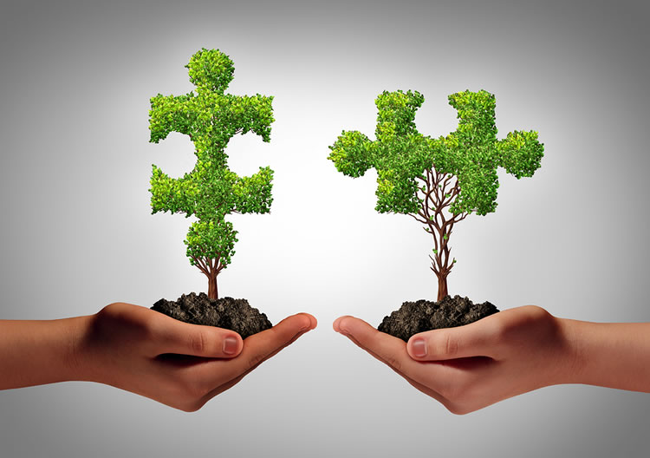

Slide 4

“All Are Welcome” Gather Hymnal #753 by Marty Haugen
“They’ll Know We are Christmas” Gather Hymnal #735 by Peter Scholtes
“Christians, Let Us Love One Another” Catholic Book of Worship III #595
by Sr. Claudia Foltz & Armand Nigro, SJ

Slide 5
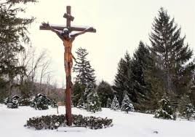

Slide 6
Opening Prayer
Lord Jesus, Master Teacher and Saviour,
Please enable us to deeply reflect upon the impact and the importance of the Golden Rule,
“In everything, do to others as you would have them do to you.” (Matthew, 7:12 NRSV)
Help us to accept, include and serve one another with love; to celebrate our diversity; to give us the courage to speak out and speak up against injustice, inequity and hatred in all forms; to open our hearts and minds to cultivate new relationships, and to do our part to repair those that are fractured.
Lord Jesus, guide us to lead like you through your scripture and your teachings, and nurture us to remain hopeful, now and always. For this, we ask your blessings.
Amen.

Slide 7
Biblical Reading
A reading from the Holy Gospel according to Matthew (5:1-2, 7:12)
When Jesus saw the crowds, he went up the mountain; and after he sat down, his disciples came to him. Then he began to speak, and taught them, saying … “In everything, do to others as you would have them do to you, for this is the law and the prophets.”
The Gospel of the Lord.
(Praise to You, Lord Jesus Christ.)
Notes:
A reading from the book of Job (Job 12:7-10,13)
Ask the animals, and they will teach you; the birds of the air, and they will tell you; ask the plants of the earth, and they will teach you; and the fish of the sea will declare to you. Who among all these does not know that the hand of the LORD has done this? In his hand is -the life of every living thing and the breath of every human being … With God are wisdom and strength; he has counsel and understanding.
The Word of the Lord. (Thanks be to God)

Slide 8
Questions for Personal Reflection
Reflect upon the Golden Rule. How do you embody the Golden Rule in your relationships with family members, friends and colleagues, and towards yourself?
Reconciliation is at the heart of cultivating relationships. When trying to reconcile a fractured relationship in the past or to be at peace with yourself that the relationship is fractured, whom did you turn to for support? Were you able to turn to prayer? Why or why not?
Have you had an opportunity to speak out or speak up against injustice or hatred? Reflect upon what you did or did not do. What would you do differently for subsequent occurrences? How does your Faith call you to respond to injustice?
In your leadership capacity, what systemic change(s) are you working towards to ensure that the connection between Faith and equity are prevalent in your work?

Slide 9
Excerpts from a Homily by Most Reverend José H. Gomez
Archbishop of Los Angeles, May 2020
When God looks at us, he sees beyond the color of our skin, or the countries where we come from, or the language that we speak. God sees only his children — beloved sons, beloved daughters … The mission that Jesus gave to his Church is the beautiful mission of gathering all the peoples of the earth into one family of God. And the Church’s mission, my brothers and sisters, is our mission. Your mission and mine …
I think we can see that we have an important responsibility to share the truth that we are all children of God, and that God loves every person … Jesus is sending each of us out to spread this message of peace, person to person, heart to heart … The peace that Jesus gives us is not the false peace of those who accept injustice out of fear or in order to avoid trouble or confrontation. The peace that Jesus gives is something we have to build, something we have to “make.” It means always working to build trust, to promote understanding, and to encourage forgiveness and friendship. It is hard work, challenging work. And we know that we cannot do it without God’s help …
When we allow the Holy Spirit to work in our lives, then we see all the goodness and beauty in the world, we see the image of God in others. And we also have a new compassion, a new sense of people’s needs and their sufferings — and we also feel our responsibility to love others for God’s sake.
(https://lacatholics.org/2020/05/31/pentecost-homily/)

Slide 10
From Pope Francis’ Encyclical Letter Fratelli Tutti
“Love, then, is more than just a series of benevolent actions. Those actions have their source in a union increasingly directed towards others, considering them of value, worthy, pleasing and beautiful apart from their physical or moral appearances. Our love for others, for who they are, moves us to seek the best for their lives. Only by cultivating this way of relating to one another will we make possible a social friendship that excludes no one and a fraternity that is open to all.”
(Pope Francis, Encyclical Letter, Fratelli Tutti, On Fraternity and Social Friendship, 2020, Number 94.)

Slide 11
Questions for Personal Reflection
What implications can these readings have for you and your relationships at school/work? At home? In your parish?
Archbishop Gomez states that “Jesus is sending each one of us out to spread the message of peace, person to person, heart to heart” but acknowledges that it can be hard and challenging work. We can sometimes become discouraged and overwhelmed. How do you nurture your own hope in order to bring hope and peace to others?
Pope Francis describes the need to cultivate a love that seeks to include and reflect the best interests of everyone. How can you help to nurture hope in your school community to ensure that it is a place of acceptance, love and belonging?

Slide 12
Closing Prayer
A Prayer to the Creator
Lord, Father of our human family,
You created all human beings equal in dignity:
pour forth into our hearts a fraternal spirit
and inspire in us a dream of renewed encounter,
dialogue, justice and peace.
Move us to create healthier societies
and a more dignified world,
a world without hunger, poverty, violence and war.
Amen.

Slide 13
Closing Prayer
A Prayer to the Creator
May our hearts be open
to all the peoples and nations of the earth.
May we recognize the goodness and beauty
that you have sown in each of us,
and thus forge bonds of unity, common projects,
and shared dreams.
Amen.
(Pope Francis, Encyclical Letter, Fratelli Tutti, 2020)
http://www.vatican.va/content/francesco/en/encyclicals/documents/papa-francesco_20201003_enciclica-fratelli-tutti.html

Slide 14
“City of God” Catholic Book of Worship III #345
“Love One Another” by Tommy Walker
“We are Many Parts” Gather Hymnal #512 by Marty Haugen

